Slide 1
Paradox Billiards
By Dark SOLZ
Mat Schweigardt, Mark Obeldobel, Daniel Lowery, Luke Zetterlund

Slide 2
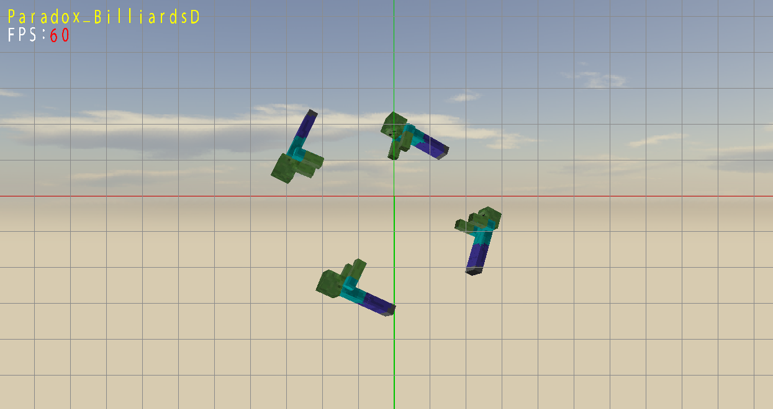
Last Time on Paradox Billiards….
-Billiards Board Simulation
-Synchronized Swimming Zombies

Slide 3
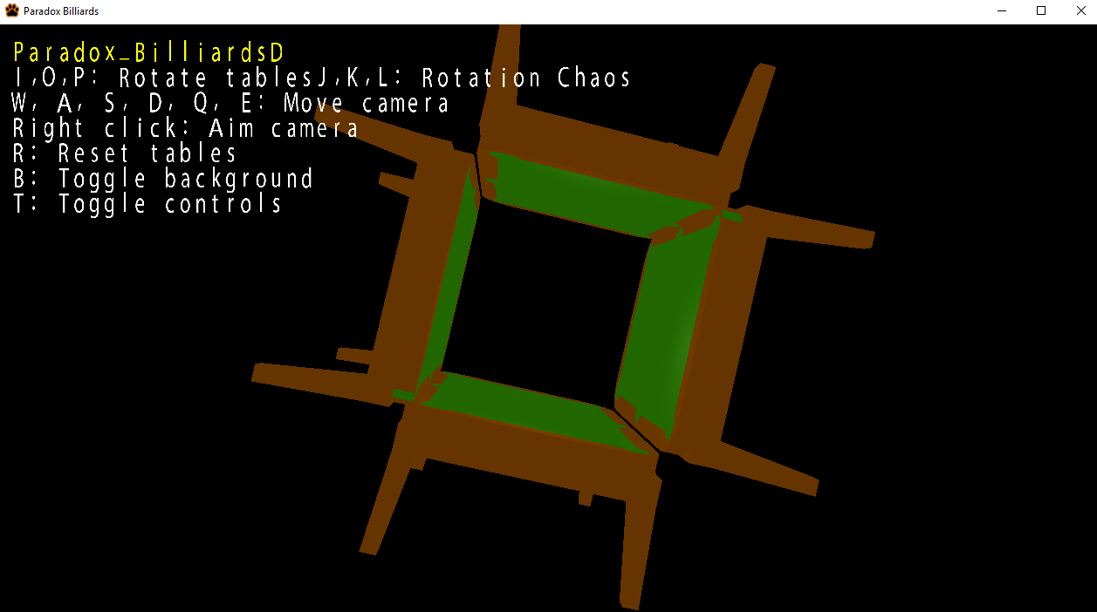
Progress
-New Skybox
(Well, this is a bad example…)
-Added pool tables
-Added UI and controls

Slide 4
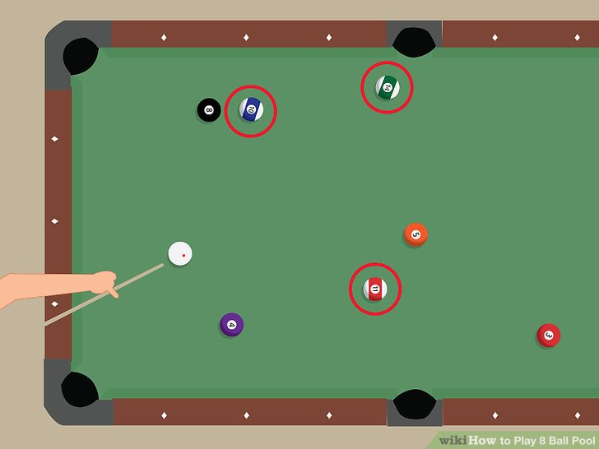
So What Now?
-Ball Physics
-Ball Physics
-Ball Physics
-Ball Physics is the Big Priority
-Clean up the skybox

Slide 5
Questions?

